Slide 1

Parameter Classes
Fred
(Friedrich Weinmann)
Twitter: @FredWeinmann
Github: FriedrichWeinmann
Email: friedrich.weinmann@powershell-stuttgart.de
Slack (PowerShell / SQL Community): Fred
PSFramework Project
PSFramework | PSUtil | PSModuleDevelopment
Owner
http://psframework.org
SQL Collaborative Project
dbatools | dbachecks
Infrastructure Architect
https://dbatools.io | https://dbachecks.io

Slide 2

2018
Parameter Classes
Making parameter binding great again!
Fred

Slide 3
The Heart of Evil
Get-ADComputer –Filter * | Test-Connection

Slide 4
The Dilemma
Types
vs.
Information

Slide 5
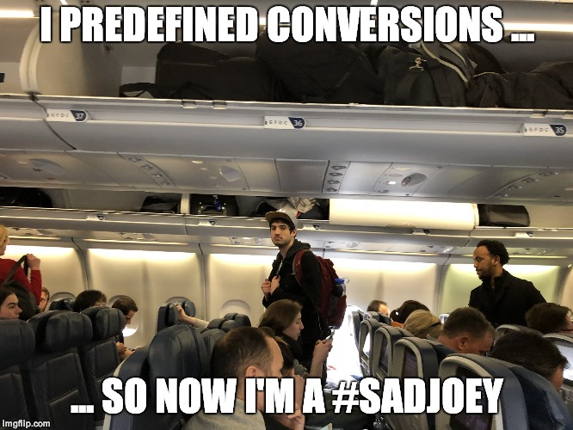
Parameter Binding
Option 1: Predefined Conversion
Option 2: Coerce
ArgumentTransformationAttribute
Correct Type
Language rules (bool, string, ...)
TypeConverter
Constructor
Implicit & Explicit cast
IConvertible
Notes:
On Option 1:
ArgumentTransformationAttributes:
System.Management.Automation.ArgumentTransformationAttribute
On Option 2:
Admin friendly documentation:
https://blogs.msdn.microsoft.com/powershell/2013/06/11/understanding-powershells-type-conversion-magic/
In code documentation (Somewhat less hostile to developers than to admins):
Conversion Rules can be found in the LanguagePrimitives.cs file
List of options is listed extensively in the internal enumeration ConversionRank (Line 249ff)
Conversion logic is described in the comments on the public ConvertTo calls, e.g. Line 1505ff
Note: All explicit line numbers last confirmed on March 21st, 2018 – always subject to change.

Slide 6
Demo

Slide 7
Summary
Parameter Classes …
accept Information, not neccessarily Types
pass the original input through
make user input more convenient

Slide 8
Next Steps
Now: 15 min break
Grab a coffee
Stay here to enjoy next presentation
Change track and switch to another room
Ask me questions or meet me in a breakout session room afterwards

Slide 9
Questions?

Slide 10
about_Author
Fred
PowerShell / devops consultant
(Friedrich Weinmann)
Twitter: @FredWeinmann
Github: FriedrichWeinmann
Email: friedrich.weinmann@powershell-stuttgart.de
Slack (PowerShell / SQL Community): Fred
PSFramework Project
PSFramework | PSUtil | PSModuleDevelopment
Owner
http://psframework.org
SQL Collaborative Project
dbatools | dbachecks
Infrastructure Architect
https://dbatools.io | https://dbachecks.io

